Slide 1
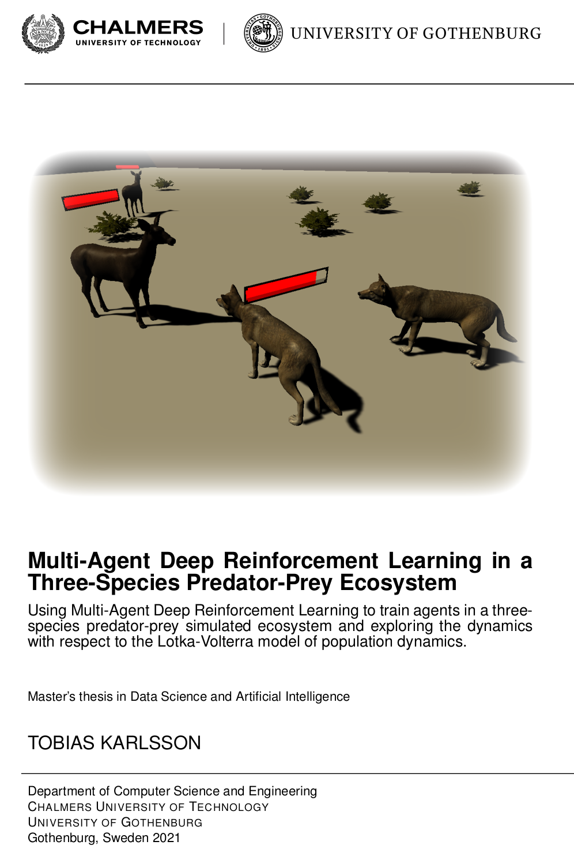
Welcome
Thesis writer: Tobias Karlsson (tobiaskarlsson314@gmail.com)
Supervisor: Claes Strannegård
Examiner: Marina Axelson-Fisk

Slide 2
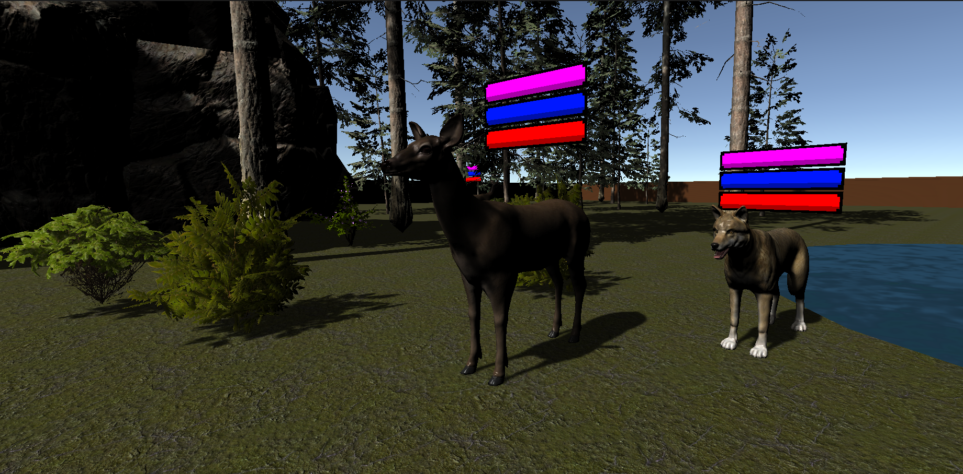
Why simulated ecosystems?
Virtual twin
Run experiments
Creating intelligent simulated animals is difficult.
Reinforcement Learning
Notes:
Ultimate goal- virtual.
Virtual twin – experiments. What happens to one species when we alter some thing. What if we cut down all the trees or setup a fence. We could also train robots to act in environment which are then inserted to the real world.
Not there yet. Intelligence lacking. Need to adapt to huge number of different situations to mimic the apadtive behavior of real world animals.
Recent developments in RL have taken us further to this goal and seem like a promising approach that we will explore in this thesis.

Slide 3
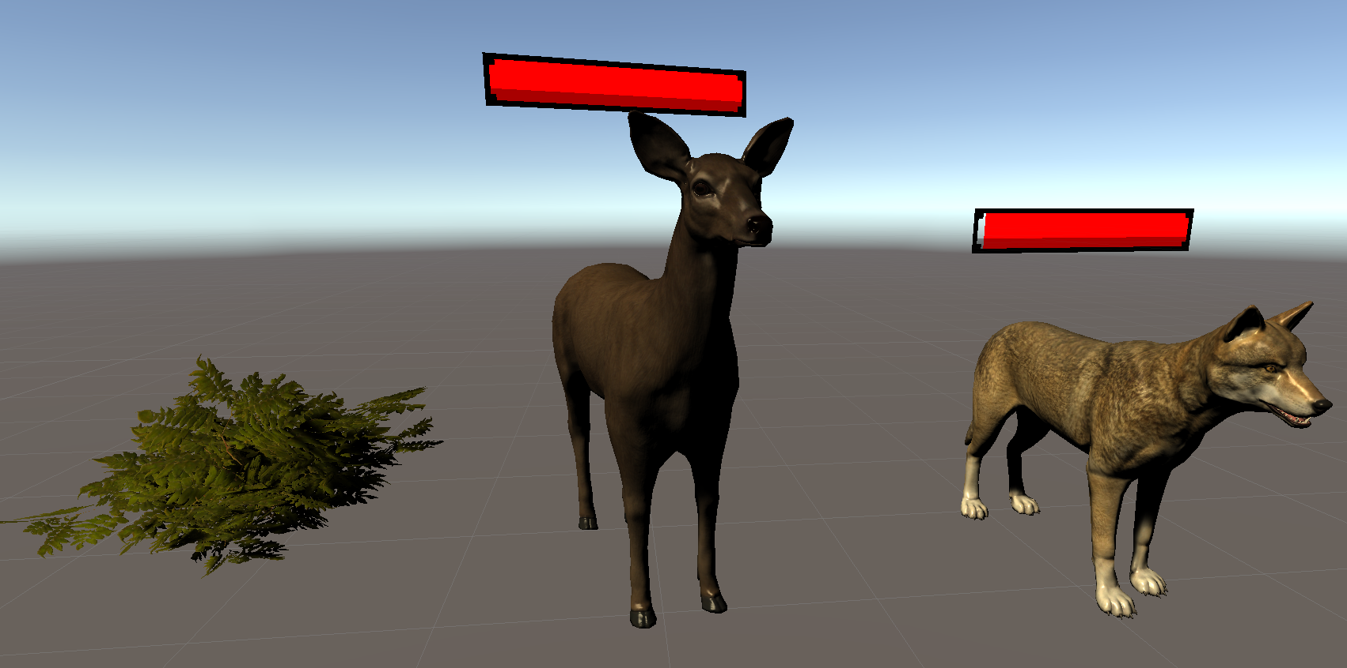
Predator-prey ecosystems
Notes:
Predator prey ecosystem consisting of three different species

Slide 4
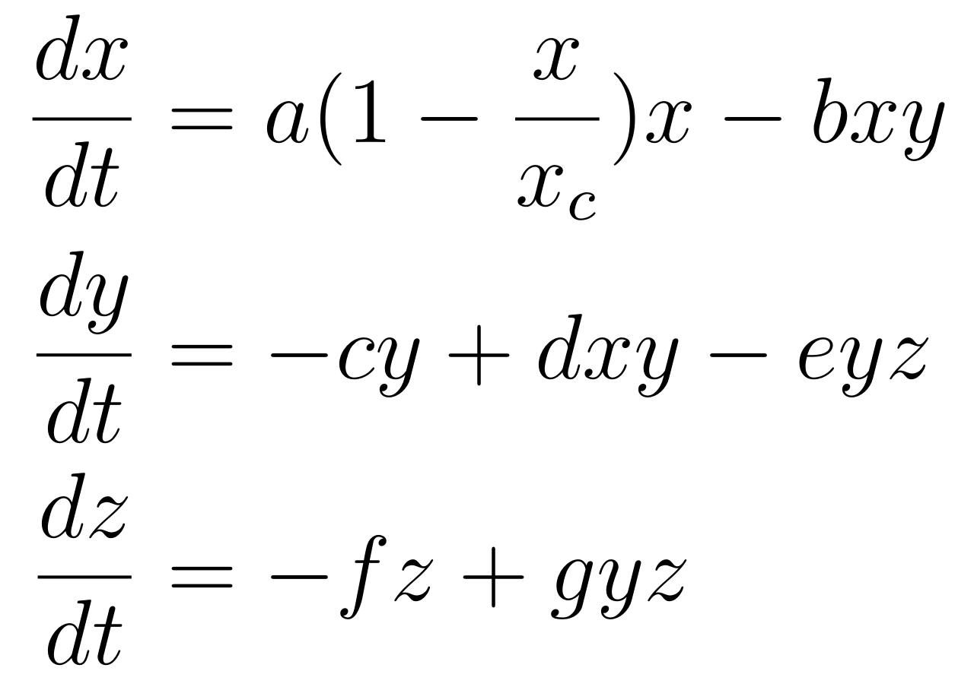
The Lotka Volterra three-species predator-prey equations
grass
deer
wolves
Notes:
In the 1920s the Lotka Volterra predator prey equations was formulated for two species. Has since been extended to consider more species and altered in different ways.
The equations describe population dynamics with a set of differential equations.
We will consider a 3 species model
The LV predator prey 3 species, Grass, Deer, Wolves.
Each DE has a several terms, describing the growth and death rates.

Slide 5
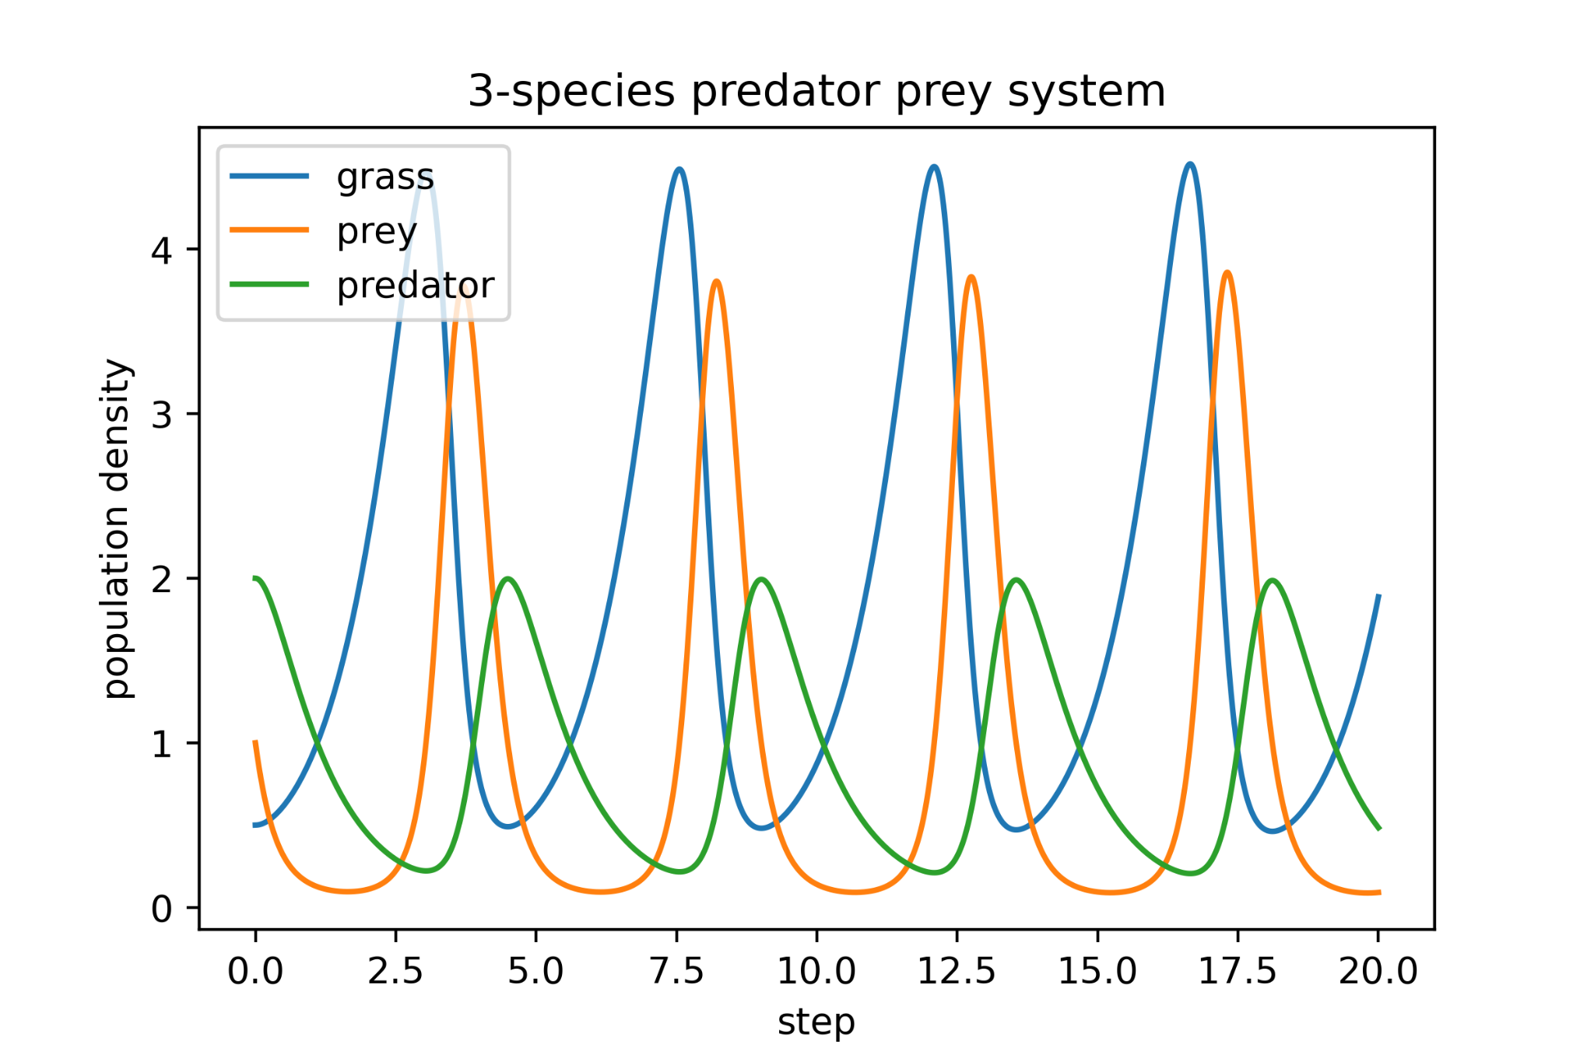
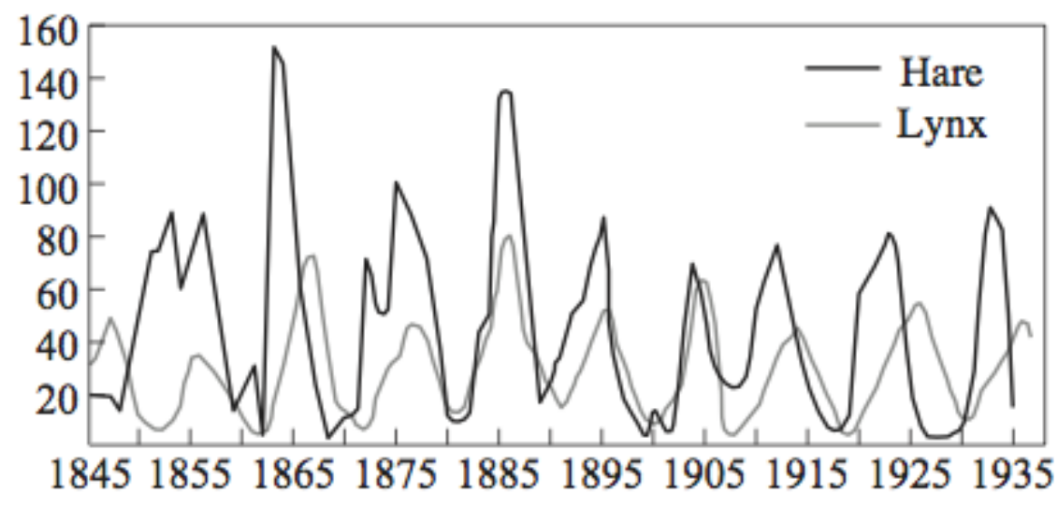
The Lotka Volterra three-species predator-prey equations
(MacLuluch, 1937)
Notes:
A key property. Cyclic dynamics under some conditions.
Left, 3 species system exhibiting cycling dynamics. You can see a peak of ...
Right real world data.

Slide 6
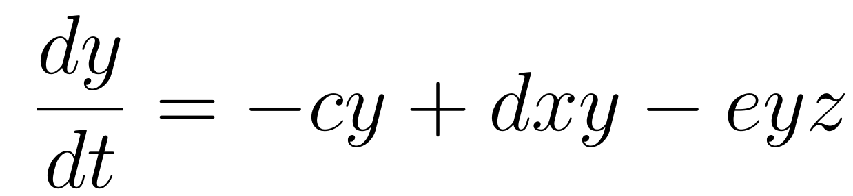
The Lotka Volterra three-species predator-prey equations
Numerical response
Functional response
Notes:
Looking at prey, three terms
Cy, the rate of death from natural causes
Dxy, the growth rate, here assumed to depend linearly on the amount of grass. Called the numerical response.
Eyz, the death from predation rate, here assumed to depend linearly on the amount of wolves. Called the funcitonal response.
These responses will be estimated.

Slide 7
Goals of the thesis
Cyclic dynamics
Parameter response estimation
Numerical response
Functional response
Notes:
Cyclic dynamics observed property of real-world ecosystems to some extent.
Estimating responses. How differ LV.

Slide 8

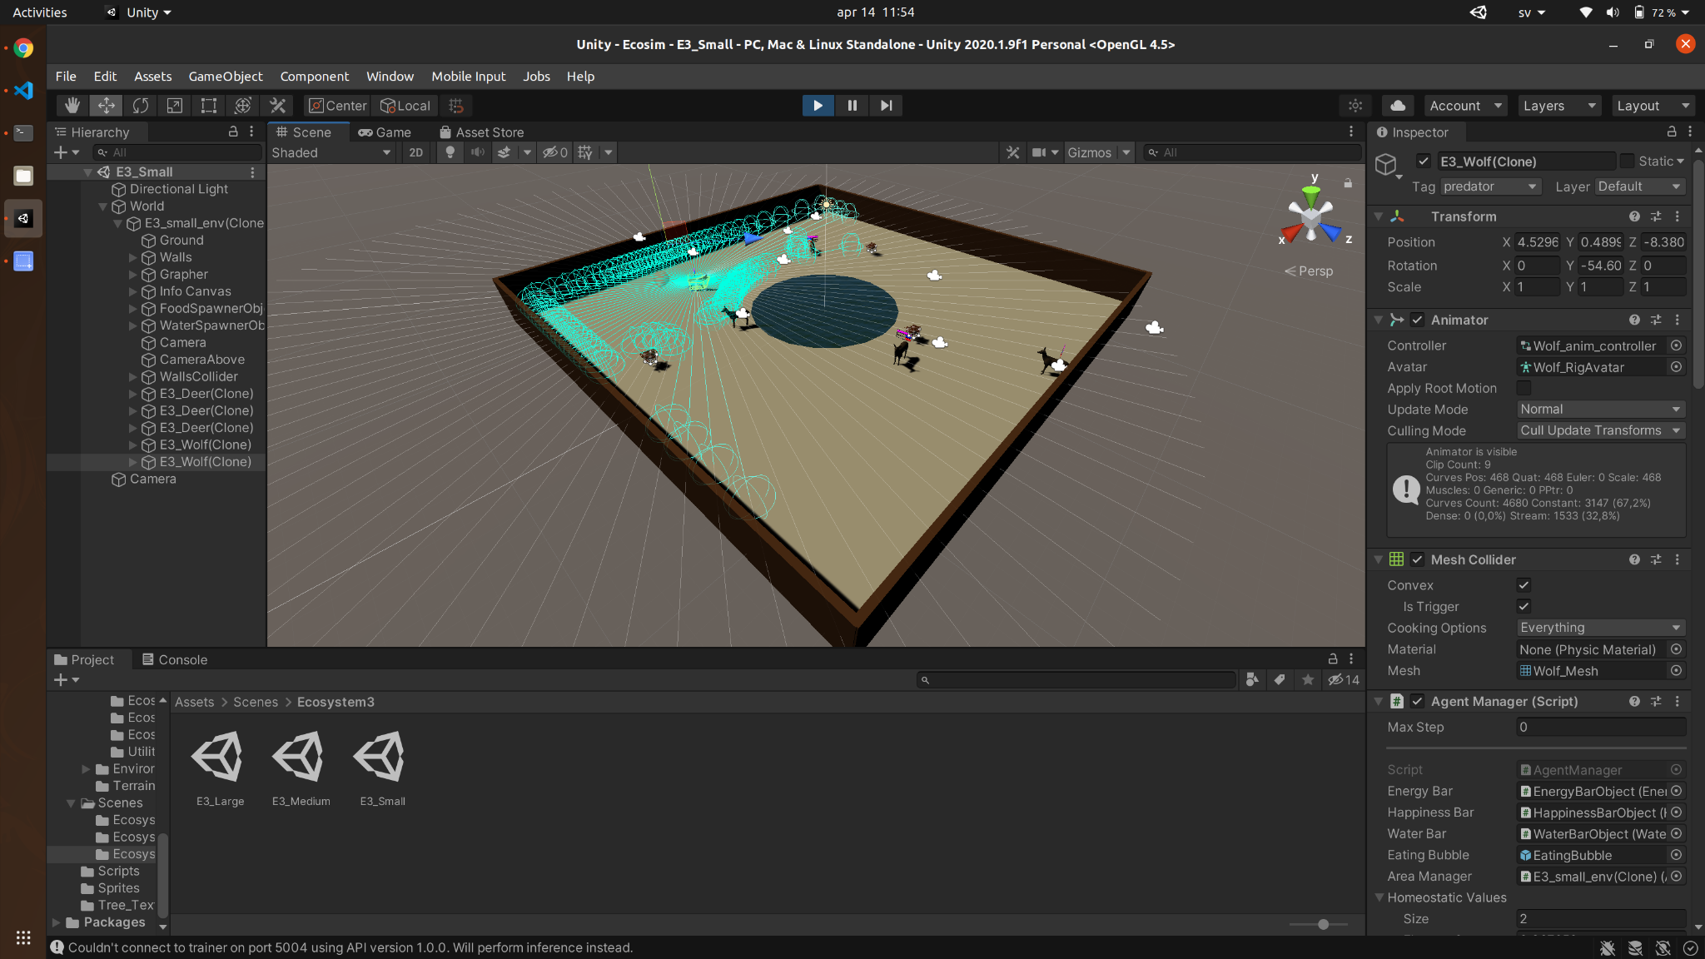
Unity
Game engine
GUI and code
Prebuilt gameobjects
Physics engine
Many other useful tools

Slide 9






Reinforcement Learning
Oops, I did not expect that to happen. I need to update my brain so I do something better next time.
What action is best given this observation?
Now I have seen it all and now the best actions to pick
Action
Agent
Observation
Reward
Environment

Slide 10
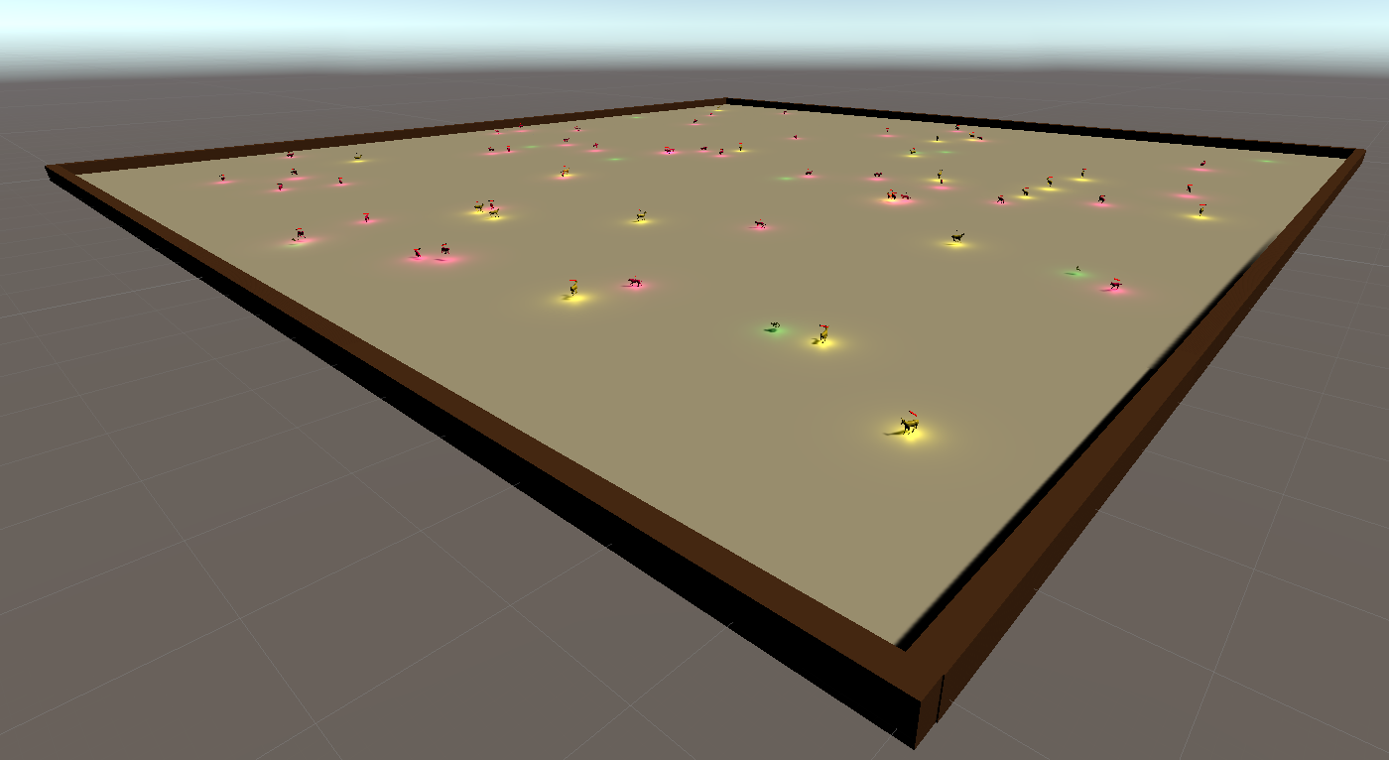
The environment
Notes:
The environment is a flat square world without any obstacles, surrounded by impassable walls.

Slide 11








Agents
Sensors
Actions
Homeostatic variables
Agents
Species
Brain
Notes:
In simulated ecosystem, 3 species, 2 agents.
Each agent has …

Slide 12
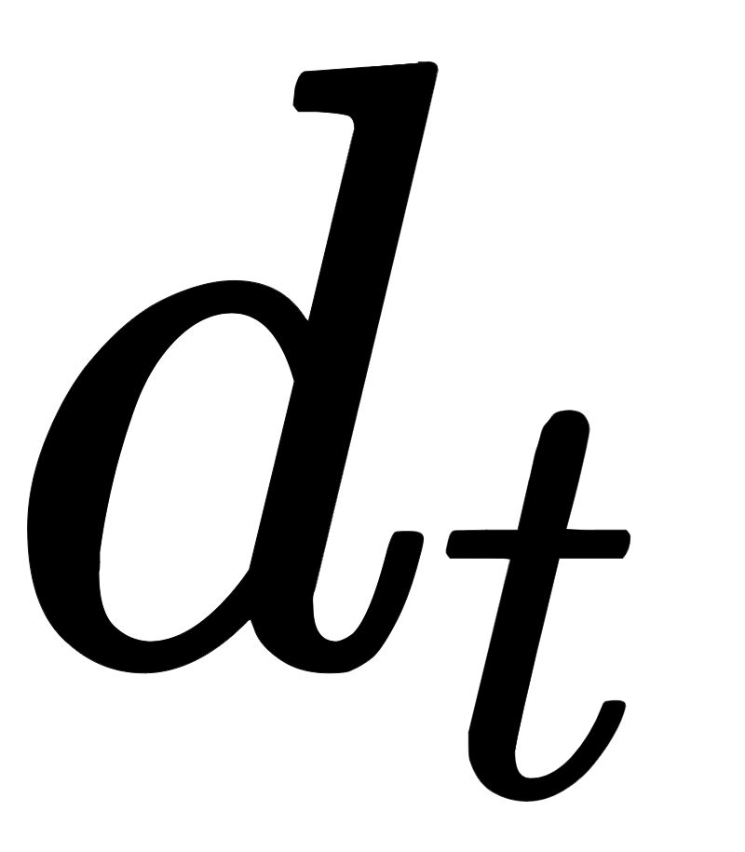

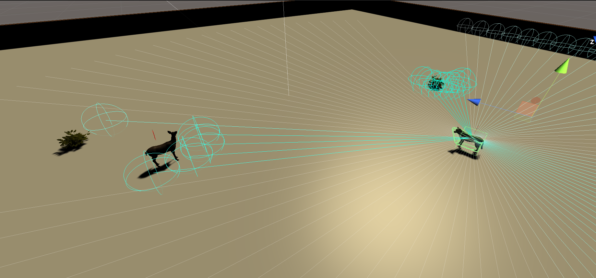
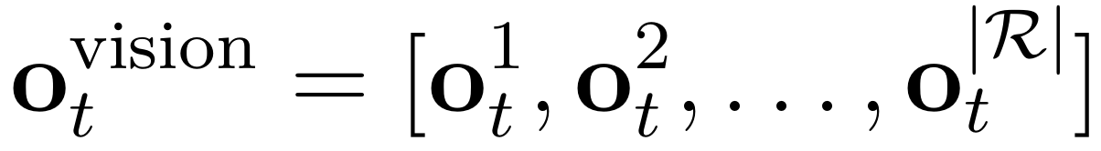
Agents
Vision
Sensors
Actions
Homeostatic variables
Brain
Notes:
The first sensor is a vision like sensor called a raycast.
At each timestep, 150 rays evenly distributed.
If a ray hit, it reports back which object that was hit and at which distance relative to the observation radius.
A complete observation

Slide 13
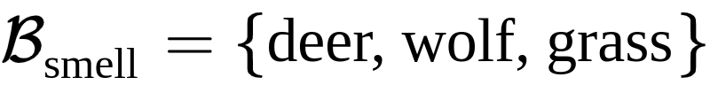
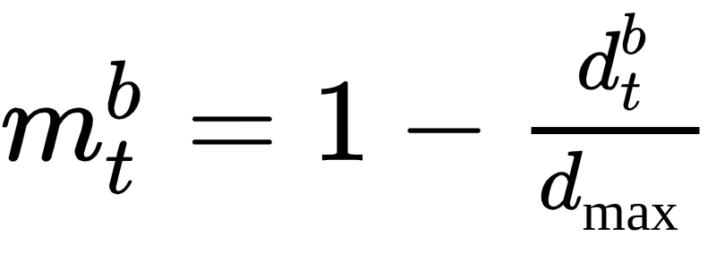
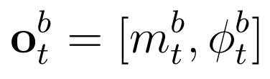
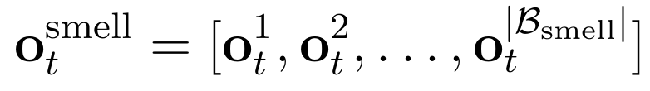
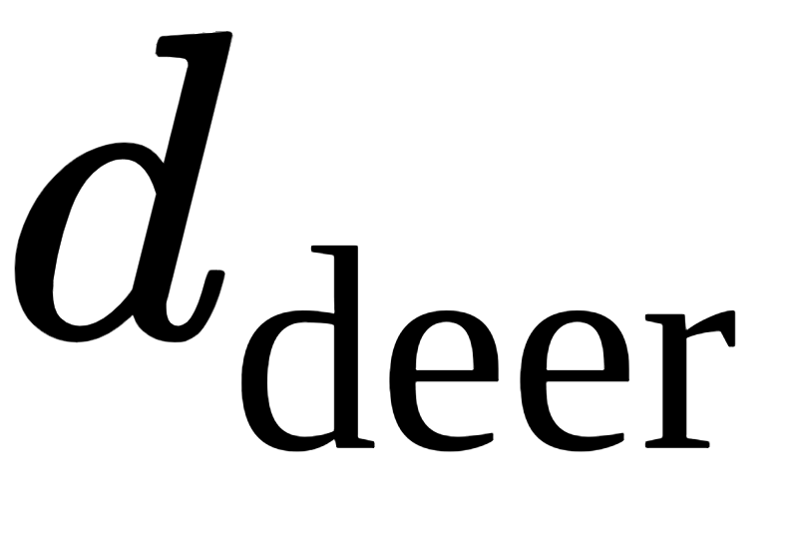

Agents
Smell
Sensors
Actions
wolf orientation
Homeostatic variables
Brain
Notes:
Smell, complement, more preprocessed, easier to interpret. Pass through other objects.
Each agent, set of smellable objects
Smell the closest object of each type if within radius
Magnitude. Angle.

Slide 14



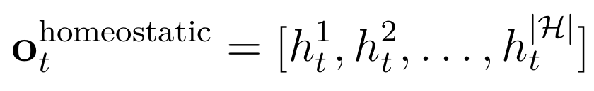
Agents
Homeostatic variables
Sensors
Actions
Homeostatic variables
Brain
Notes:
1. Homeostatic variables refers to the internal variables that the body tries to regulate and keep within a certain range in order to function. Such as energy, water levels and temperature.
2. The agent observes its homeostatic variables.

Slide 15

Agents
Complete observation
Sensors
The deer is moving to the left
Notes:
At each timestep the three most recent observations for each sensor is observed.
Possibly to infer movement of objects and homeostatics.

Slide 16
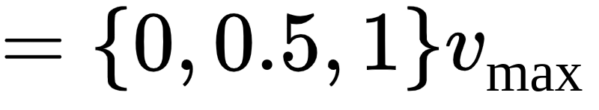
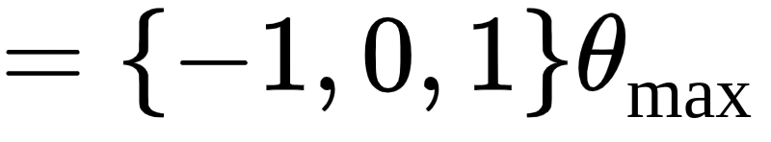
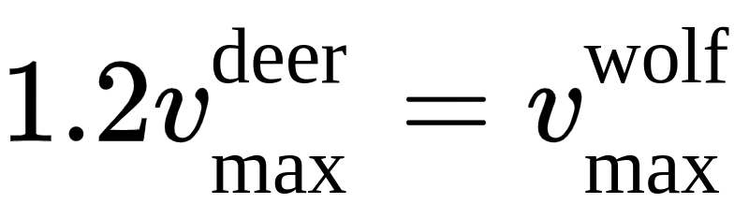
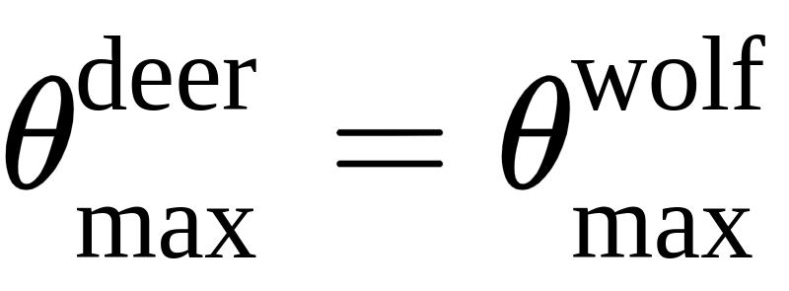
Agents
Sensors
Actions
Homeostatic variables
Brain
Notes:
Each timestep, two discrete actions.
Wolf faster, outrun.

Slide 17
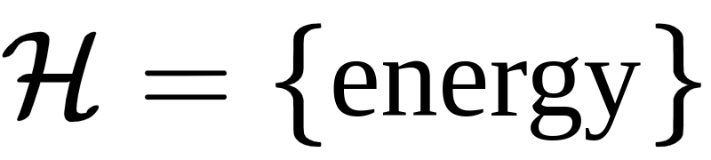
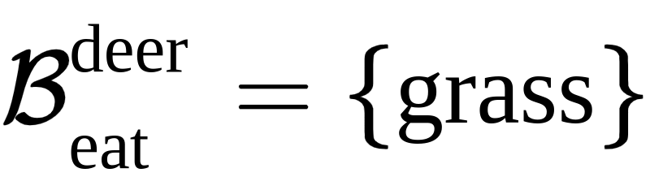
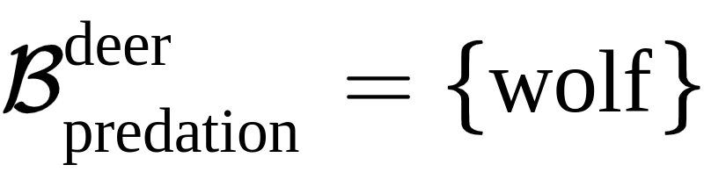
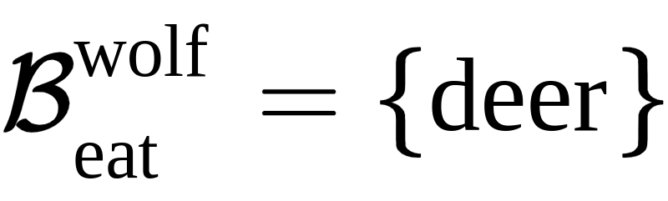

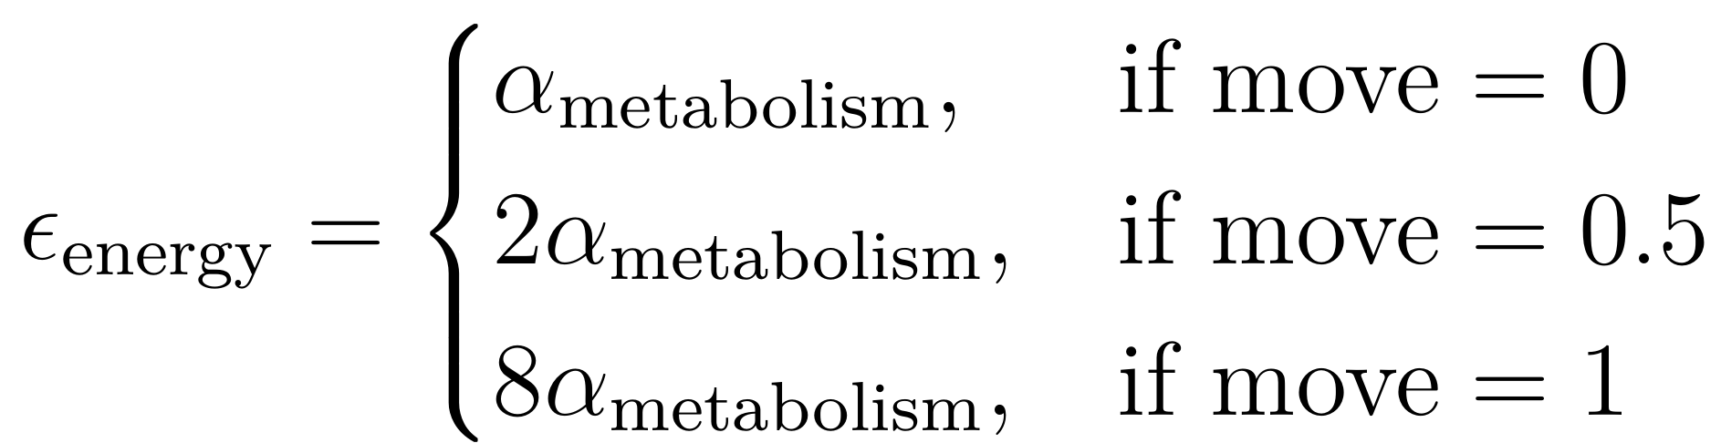
Agents
Sensors
Actions
Homeostatic variables
Brain
Notes:
The agents only have one homeostatic variable, energy.

Slide 18





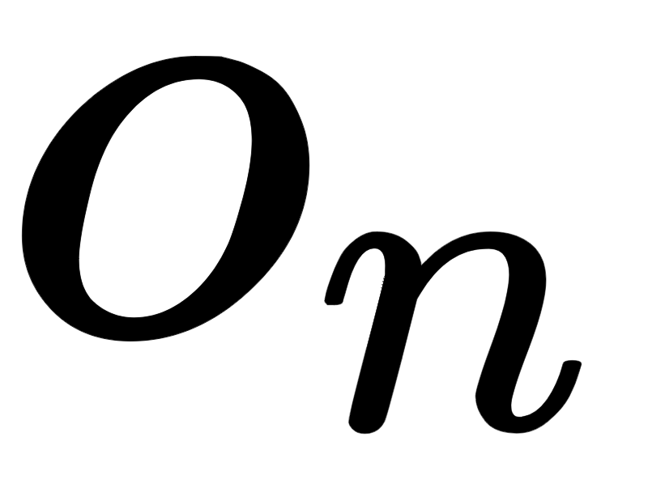
Agents
Sensors
Actions
Homeostatic variables
2 hidden layers, each 128 with neurons
Brain
Notes:
Consist of NN
Input, output
The brain trained to select actions. Maximize cumulative reward.
Each edge and node has a weight and a bias.
Training means optimize the values of weights and biases of nodes and edges.
Use PPO. State of art RL algorithm known for its good convergence properties.

Slide 19

Reproduction
Each of you have 0.001 probability to get a child per timestep!
Notes:
Reproduction not based on meetings.
Each agent probability to give offspring

Slide 20

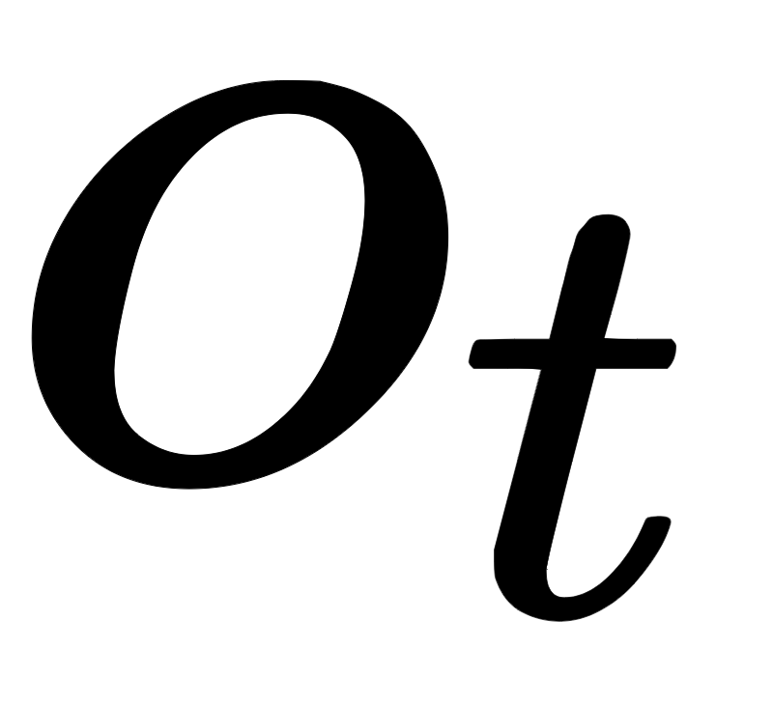

Multi-Agent Reinforcement Learning
Deer Brain
Wolf Brain
Centralized Learning, Decentralized Execution
Notes:
MARL.
Each agent tries to find optimal behavior, but this changes as other agents change their behavior... Not a static environment.
Many different schedules.
Cecentralized learning, decentralized execution.
Each specie individual brain

Slide 21
Reinforcement Learning
Action
Agent
Observation, Reward
Environment
How should the agent be rewarded?
Notes:
RL

Slide 22

The Happiness Network
External reward signals
Homeostatic regulation (Negative-Feedback)
The Happiness Network
Notes:
Behavioral science consider two types of reward systems.
In RL typically only external. Used to anticipate things that may lead to good states, such as the smell of food.
Homeostatic regulation on the other hand. Directly considers internal state. Rewarding actions that brings homeostatic variables closer to optimal values.
We consider a combination of the two, Happiness Network.

Slide 23
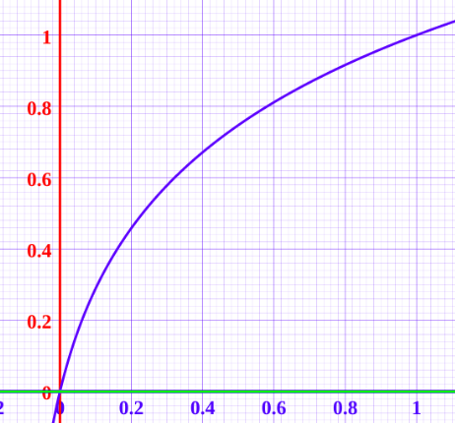
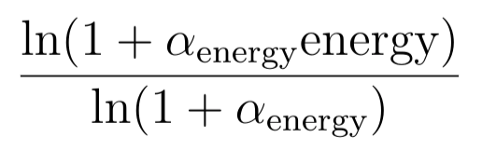
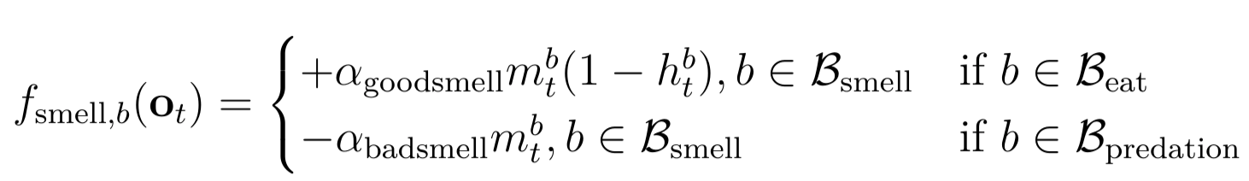
The Happiness Function
Homeostatic Regulation
External reward signals
Notes:
Constructing a Happiness function is a research topic in itself.
We were actually three master thesis groups working with simulated ecosystems...
One considered the construction Happiness.
My happiness builds upon the same concept but with a different way of combining the two.
The Happiness function, two terms.
Value of energy from 0 to 1 with 1 being optimal
Associated happiness for this homeostatic variable has domain 0 to 1, where happiness changes more rapidly when the variable is close to 0.
Good and bad smells.
Good smell proporional to magnitude of smell of food and how hungry
Bad smell is magnitude of smell of predators.
Addtional to. Death

Slide 24
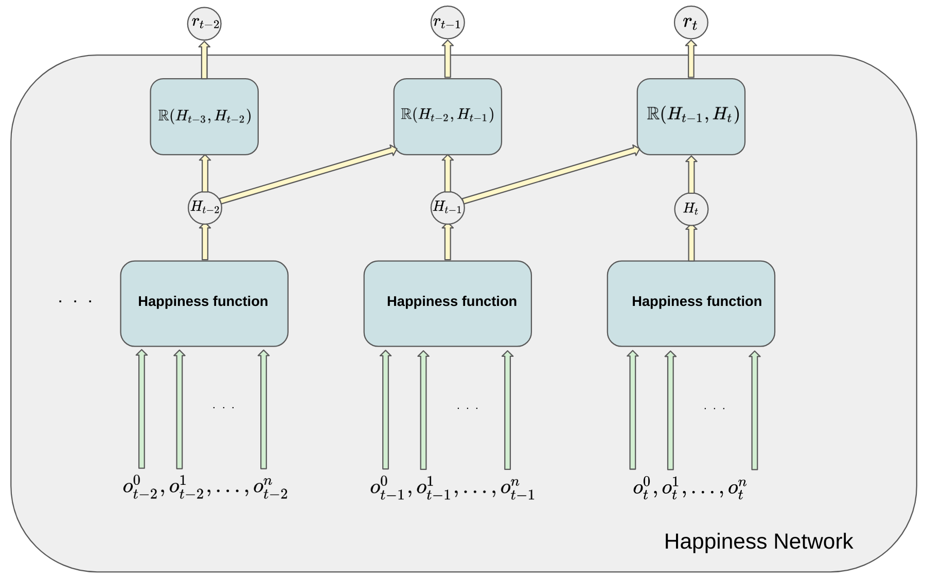

The Happiness Network
Notes:
The complete happiness network. Gives reward
Difference in happiness compared with previous timestep.

Slide 25


Simulations
Pretraining
Population experiments
Notes:
Simulations, two phases
Pretraining, fixed populations. Get brain for each specie. Run for around 10 million steps.
Population experiments, initialized with brains. Run with around 100k steps.

Slide 26
Video

Slide 27
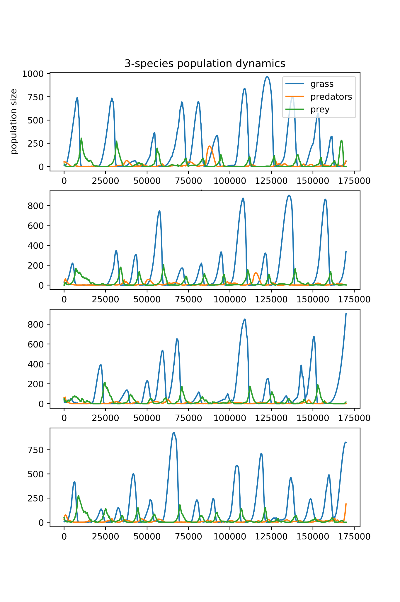
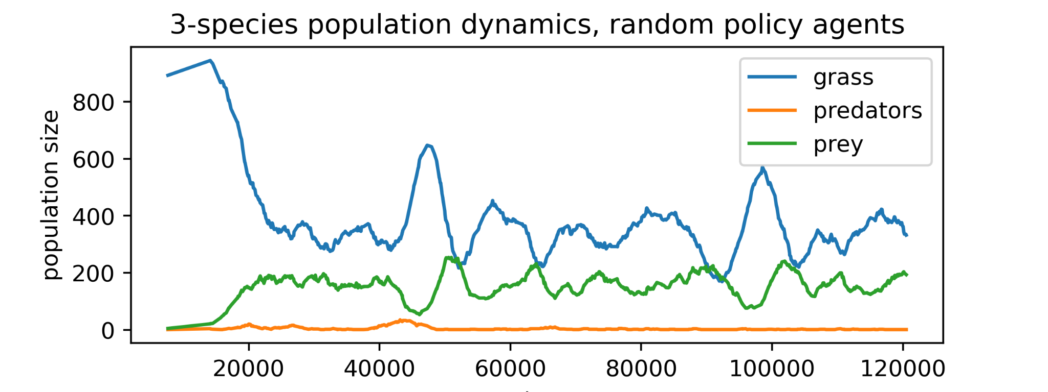
Population dynamics
Notes:
Here 4 different population simulations initialized
Cycles. Stochastic. One reason, not infinite population sizes. Secondly, decision making of spatially distributed agents gives non deterministic system. This is confirmed in other research.
Random policy agent does not exhibit cycles.

Slide 28
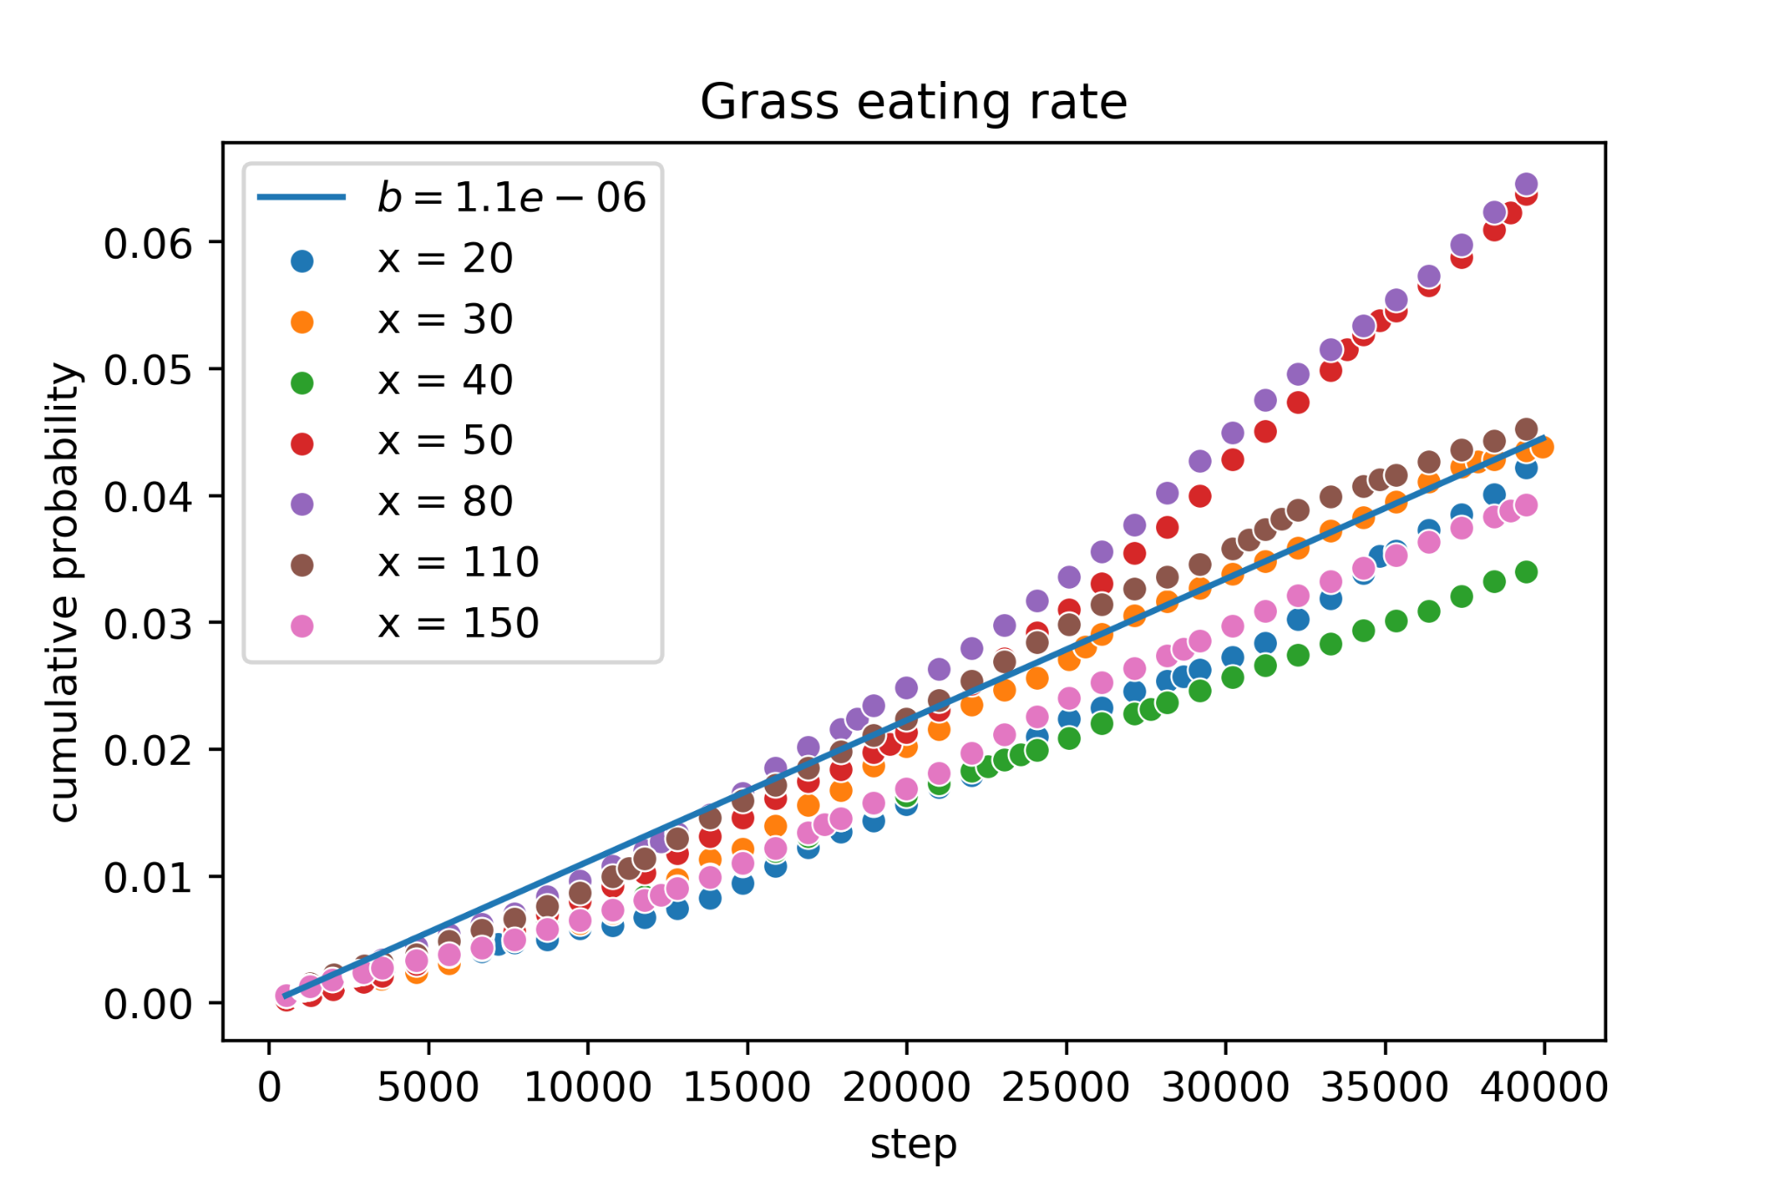
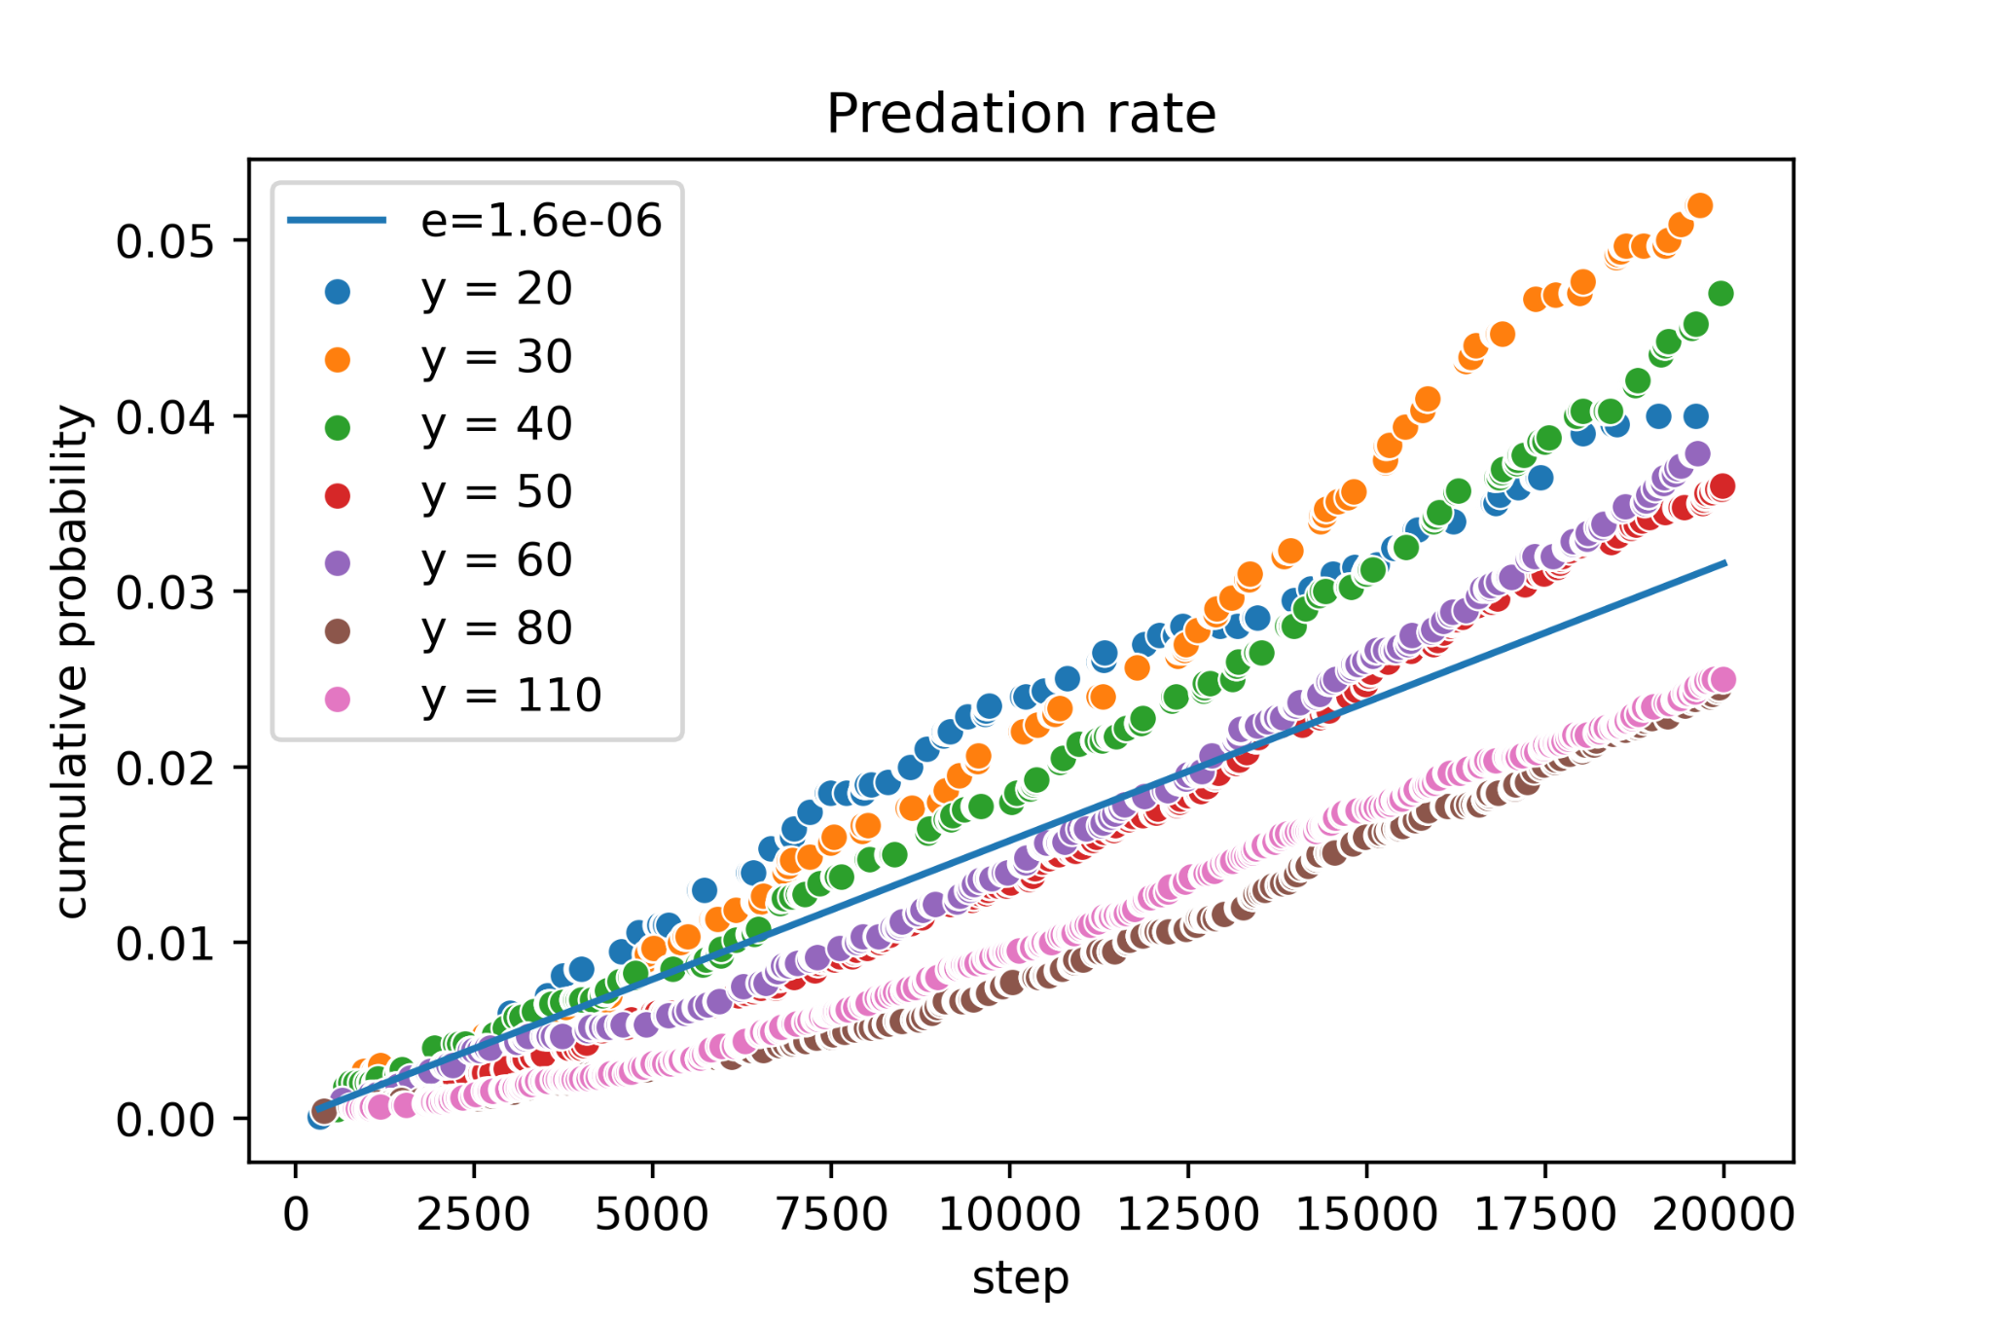
Parameter response estimation
Notes:
Estimate the functional response. How eating rates changes with changing food density.
What we do is: Fix amount of food and measure how much that has been eaten.

Slide 29
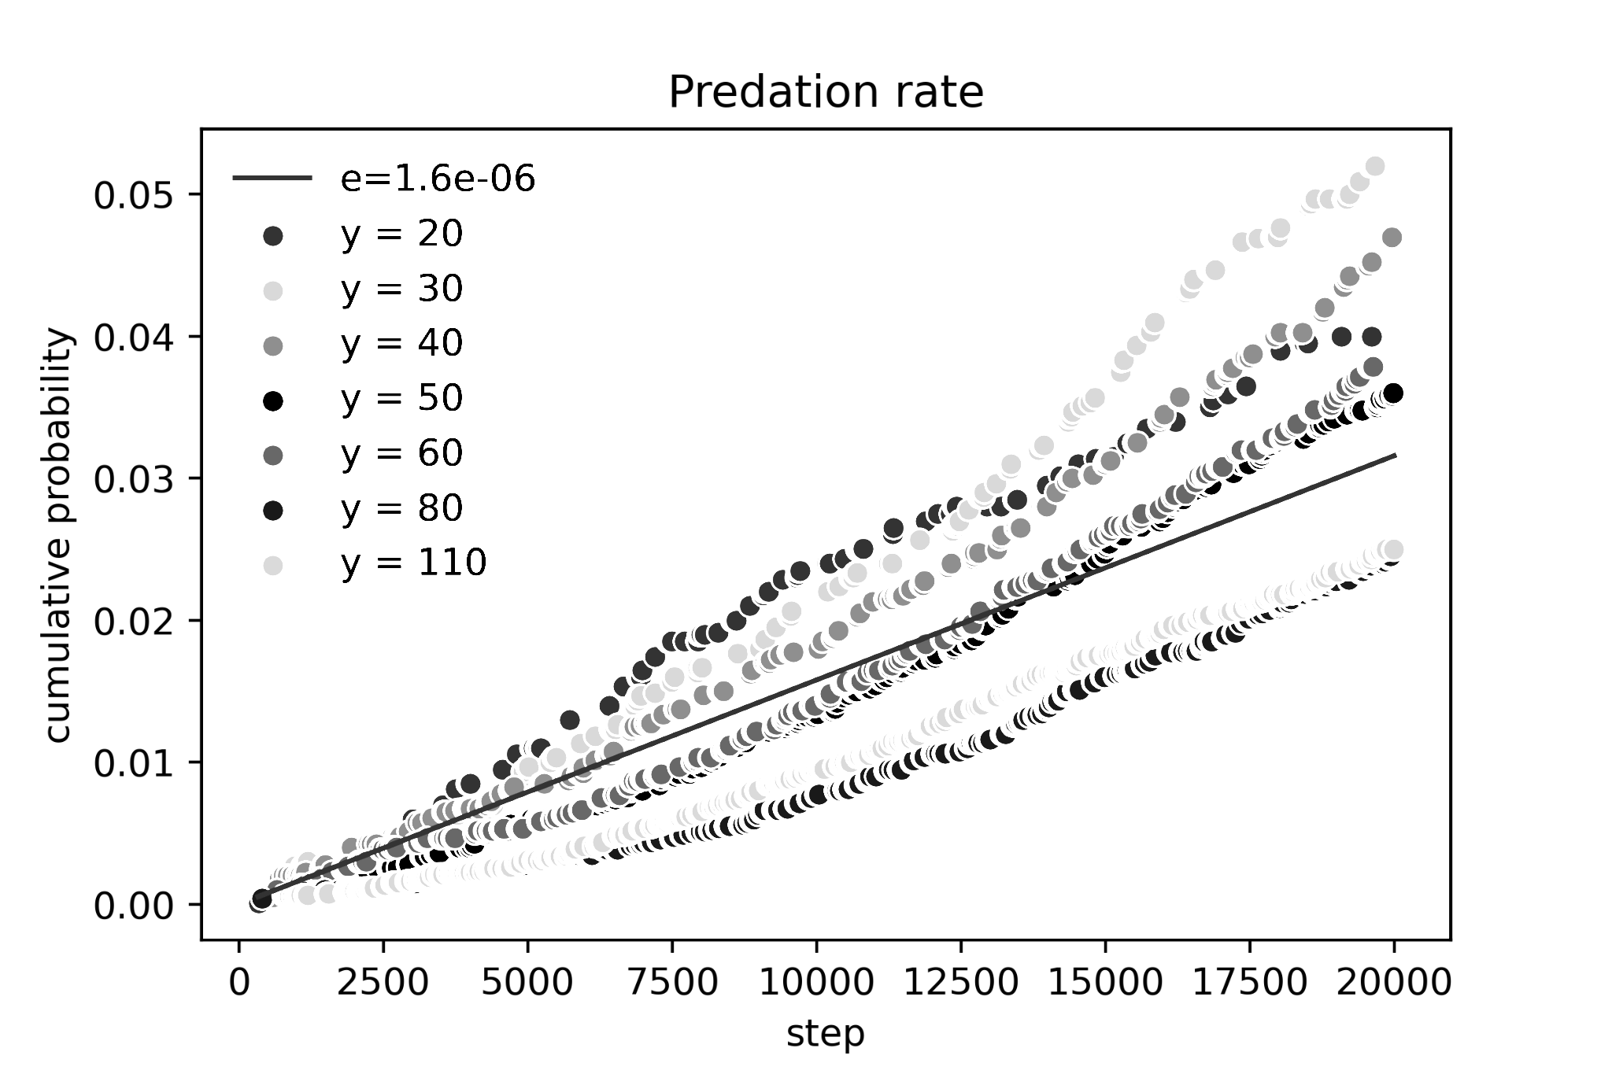
Parameter response estimation
Functional response is nonlinear
Notes:
Interestingly, for the predation rate e, it gets lower when the density of deers increases.
Deer living in.. Smaller risk of predation
In contrast. The LV assumes that the risk of predation is constant. Increasing deer... Increasing killing at equal rate.
But our measurements show that the functional response is nonlinear.

Slide 30
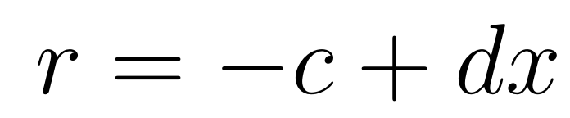
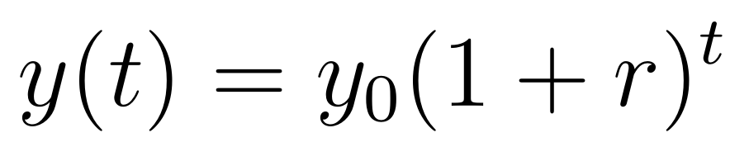
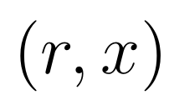
Parameter response estimation
Notes:
To estimate the numerical response for deers. No wolves
Get the aggregate growth rate r.
By measuring the population changes at different fixed grass densities x. We get (r,x) tuples.
These are used to fit the linear equation for r which gives us an estimation of c and d.
The exact same procedure is done for f and g by fixing deer densities and measuring wolf population changes.

Slide 31
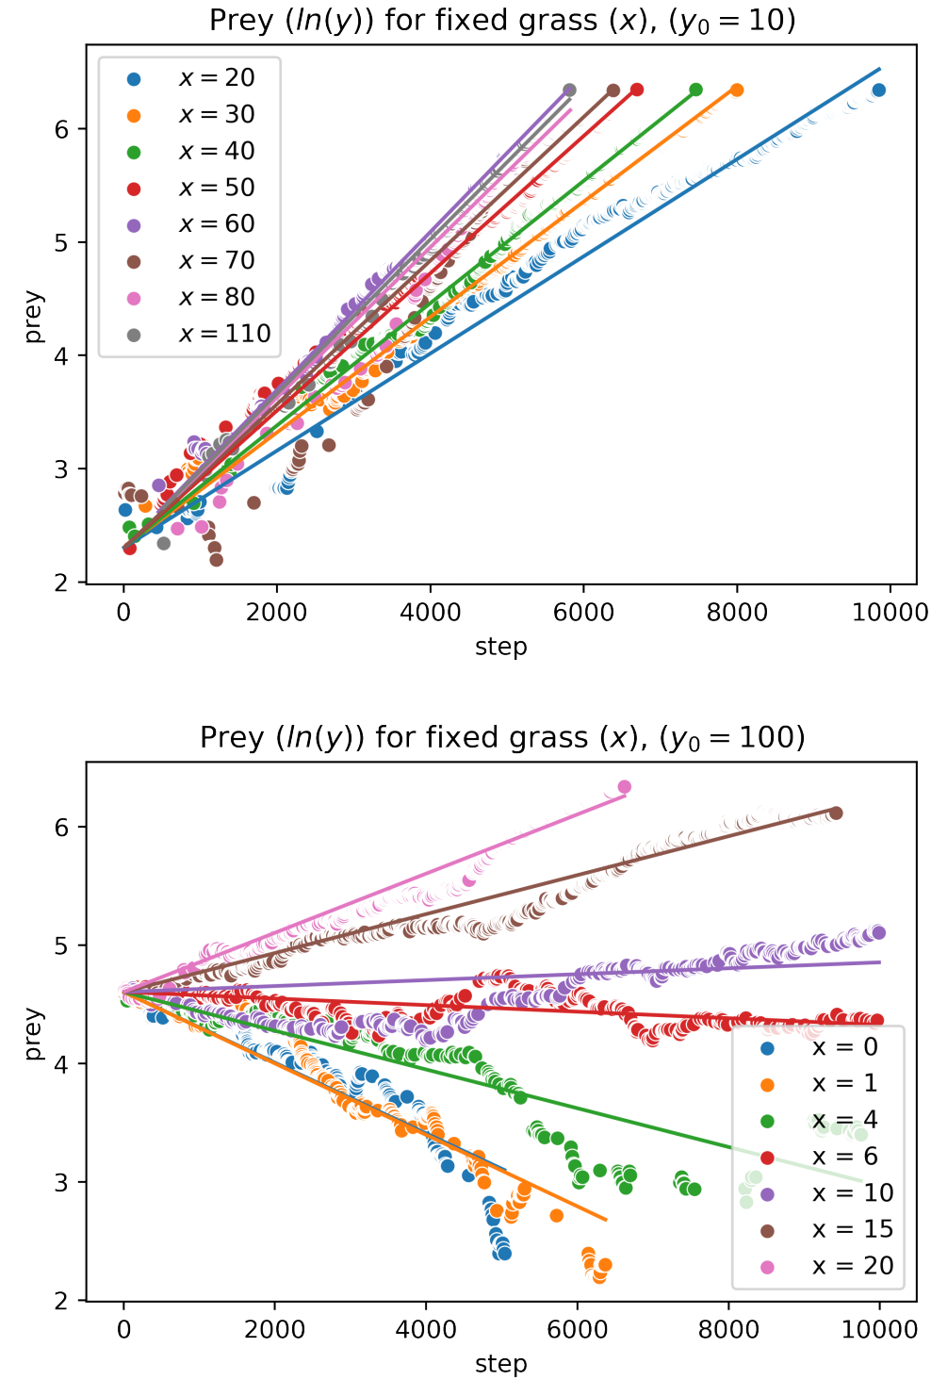
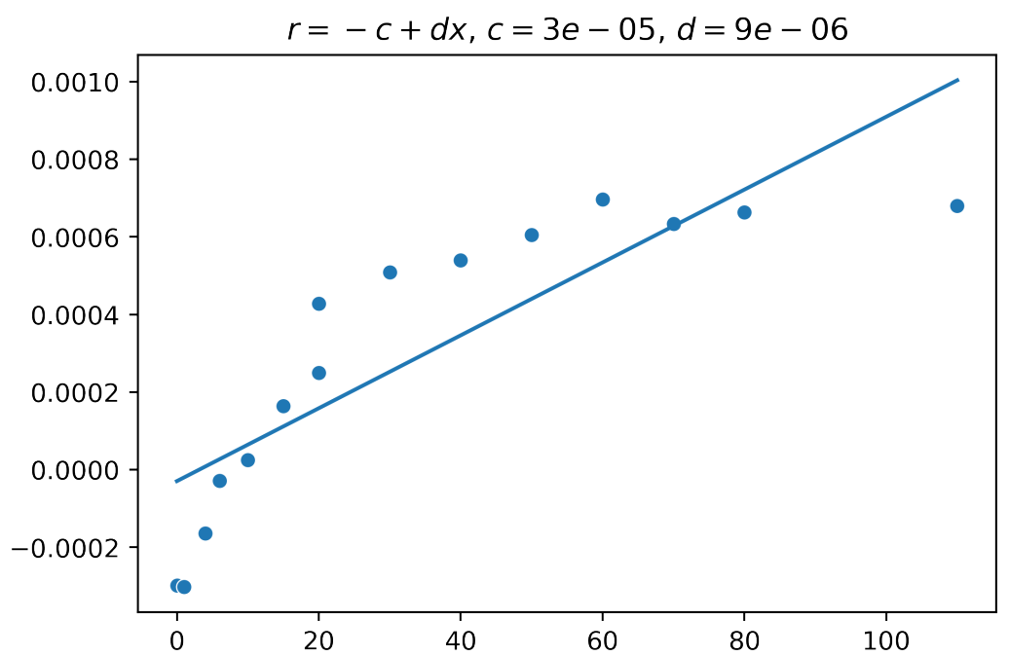
Parameter response estimation
Notes:
To the left, logartihmized population size as function of step.
Linear, means exponential changes in population, similar to what the LV model assumes.
However, non-linear numerical response for r.

Slide 32
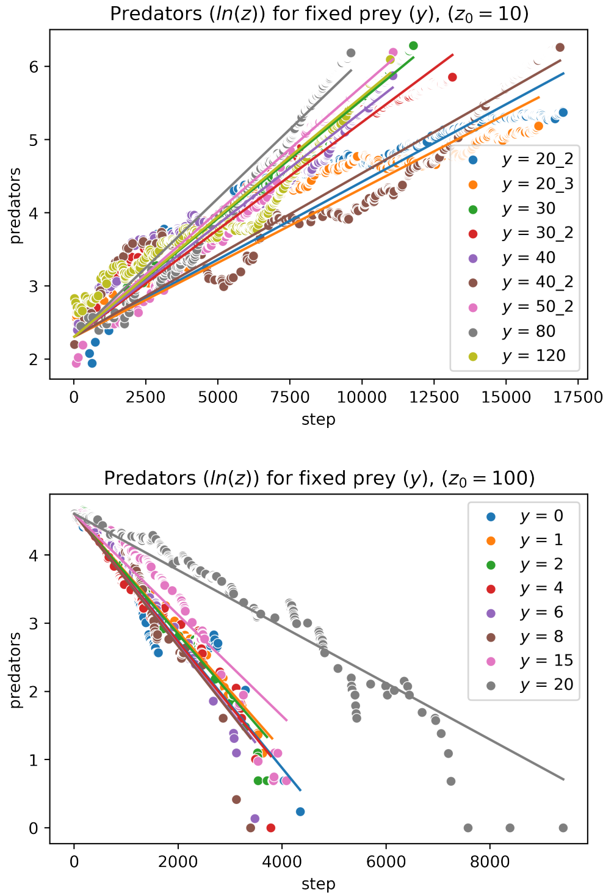
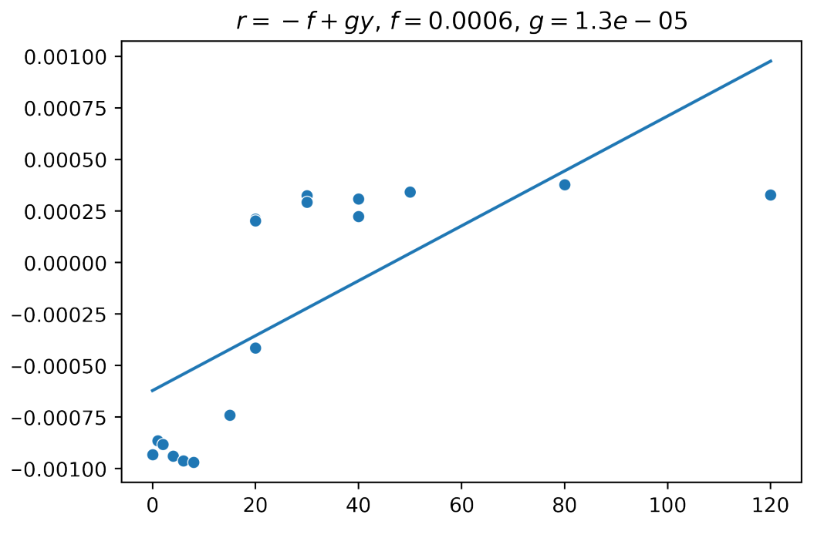
Parameter response estimation
Notes:
1. This is even more apparent for the wolves.

Slide 33
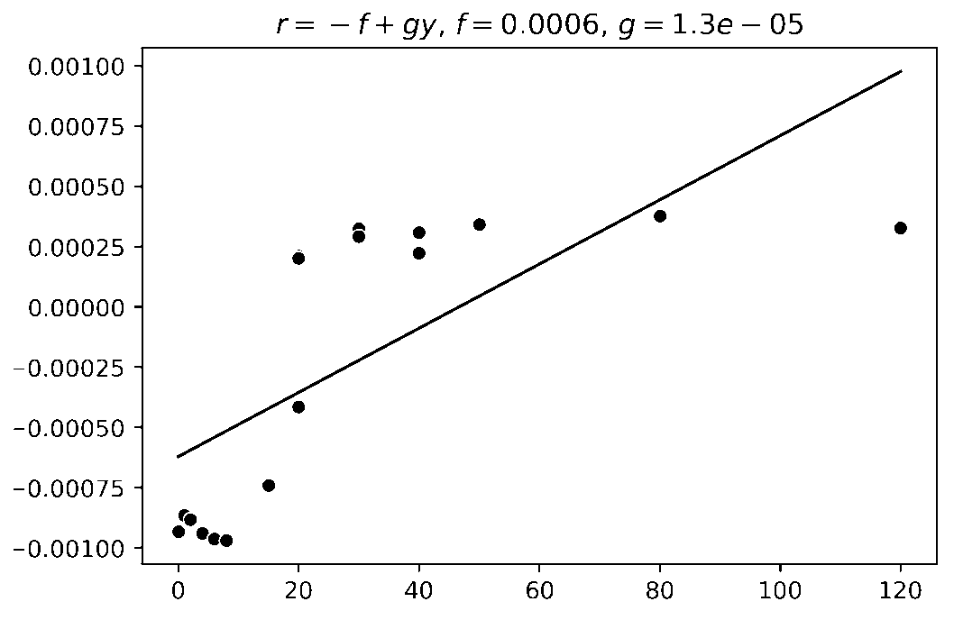
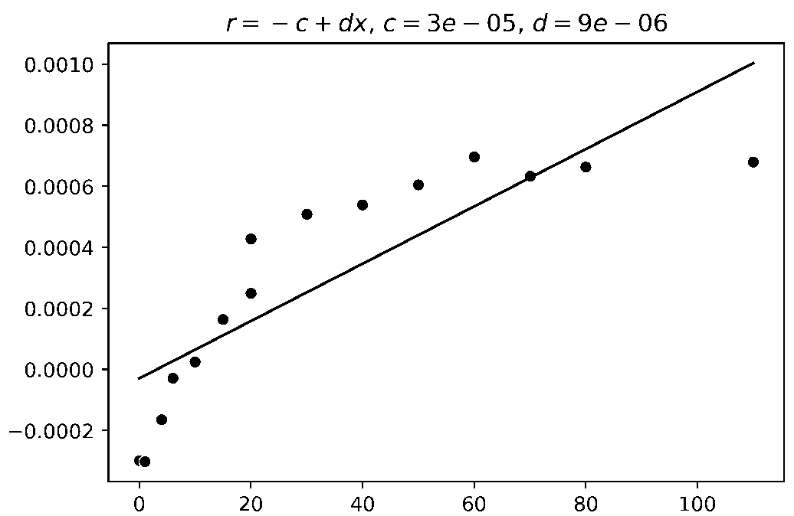
Parameter response estimation
The numerical response is nonlinear
Notes:
If food population larger than 20, the growth rate starts to converge.
Throwing more food at them than this will not make the population grow much faster.
In contrast, the LV model assumes, more food means faster reproduction.
But our measurements show that our numerical response is nonlinear.

Slide 34
Parameter response estimation
So what? The LV model is already known to be unrealistic
We can argue that this simulation environment has more realistic dynamics than the LV model.
The simulation environment can be used to estimate responses to create more accurate models.
Notes:
LÄS FRÅN SLIDE.

Slide 35
Parameter response estimation
Why does this happen?
Functional response is nonlinear
Functional response: Not infinite appetite.
Numerical response: Food not converted to offspring. If alive, you can reproduce. If everyone survives, we wont increase reproduction rate by providing more food.
The numerical response is nonlinear
Notes:
LÄS FRÅN SLIDE

Slide 36
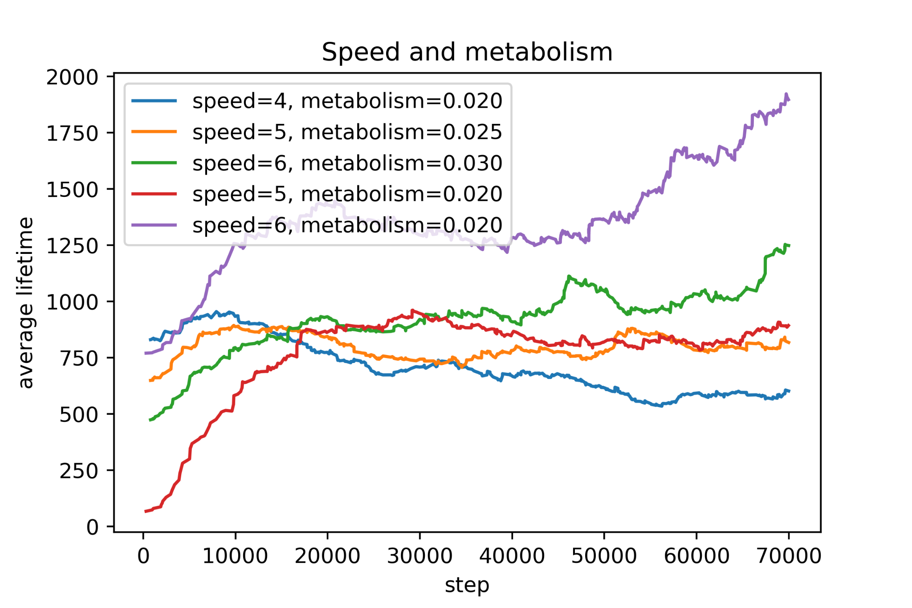
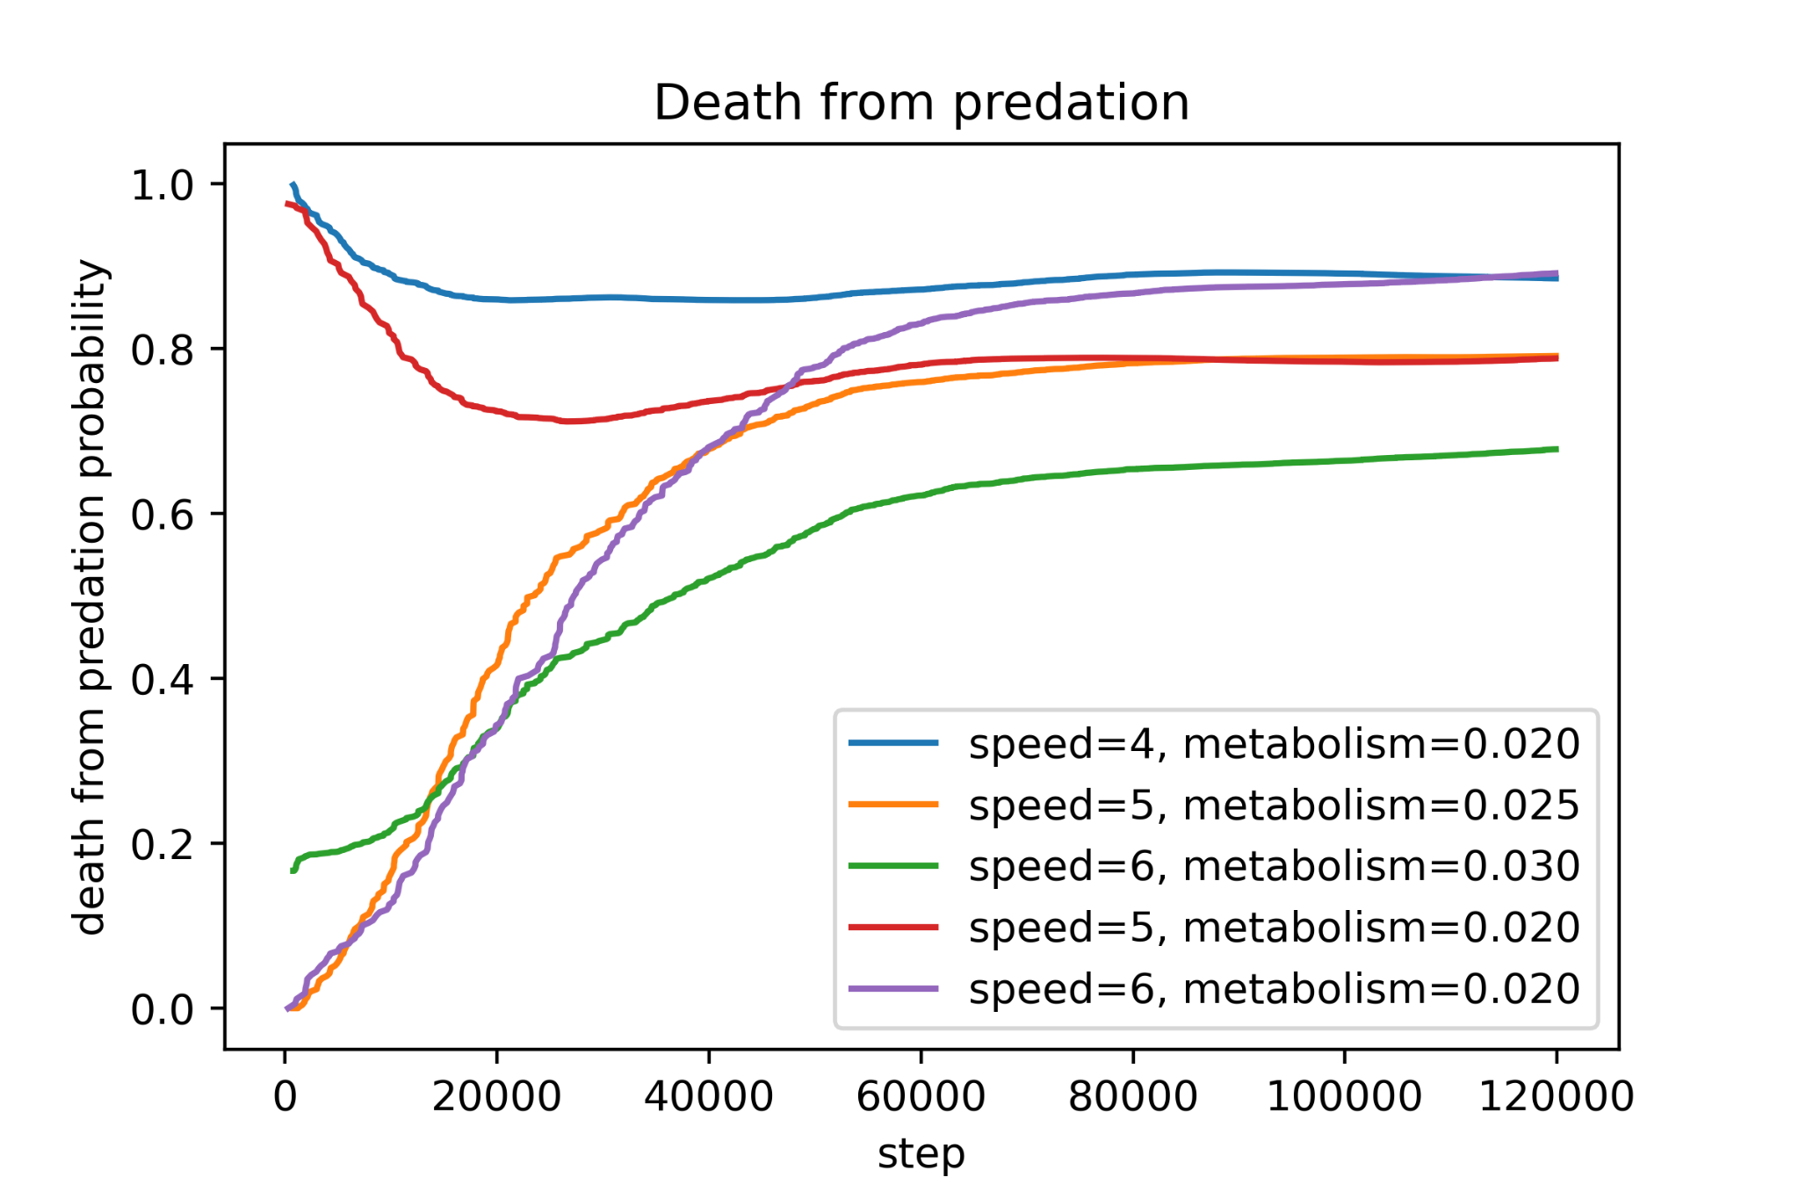
Survival properties
Notes:
A brief experiment of changing physical configurations for the prey was performed.
The speed and metabolism of deer was altered and lifetime measured.
The original setting was a deer had a speed of 4.
Faster deer, longer lifetimes. Even when metabolism increased equally.
The causes of death for each configuration was also monitored.
Fastest vs slowest deer with equal metabolism had equal probability death but fastest had longer lifetime.
Means that faster deer was both better at finding food and escaping wolves.
This was mainly done as a showcase of what type of experiments that can be performed in a simulated ecosystem.

Slide 37
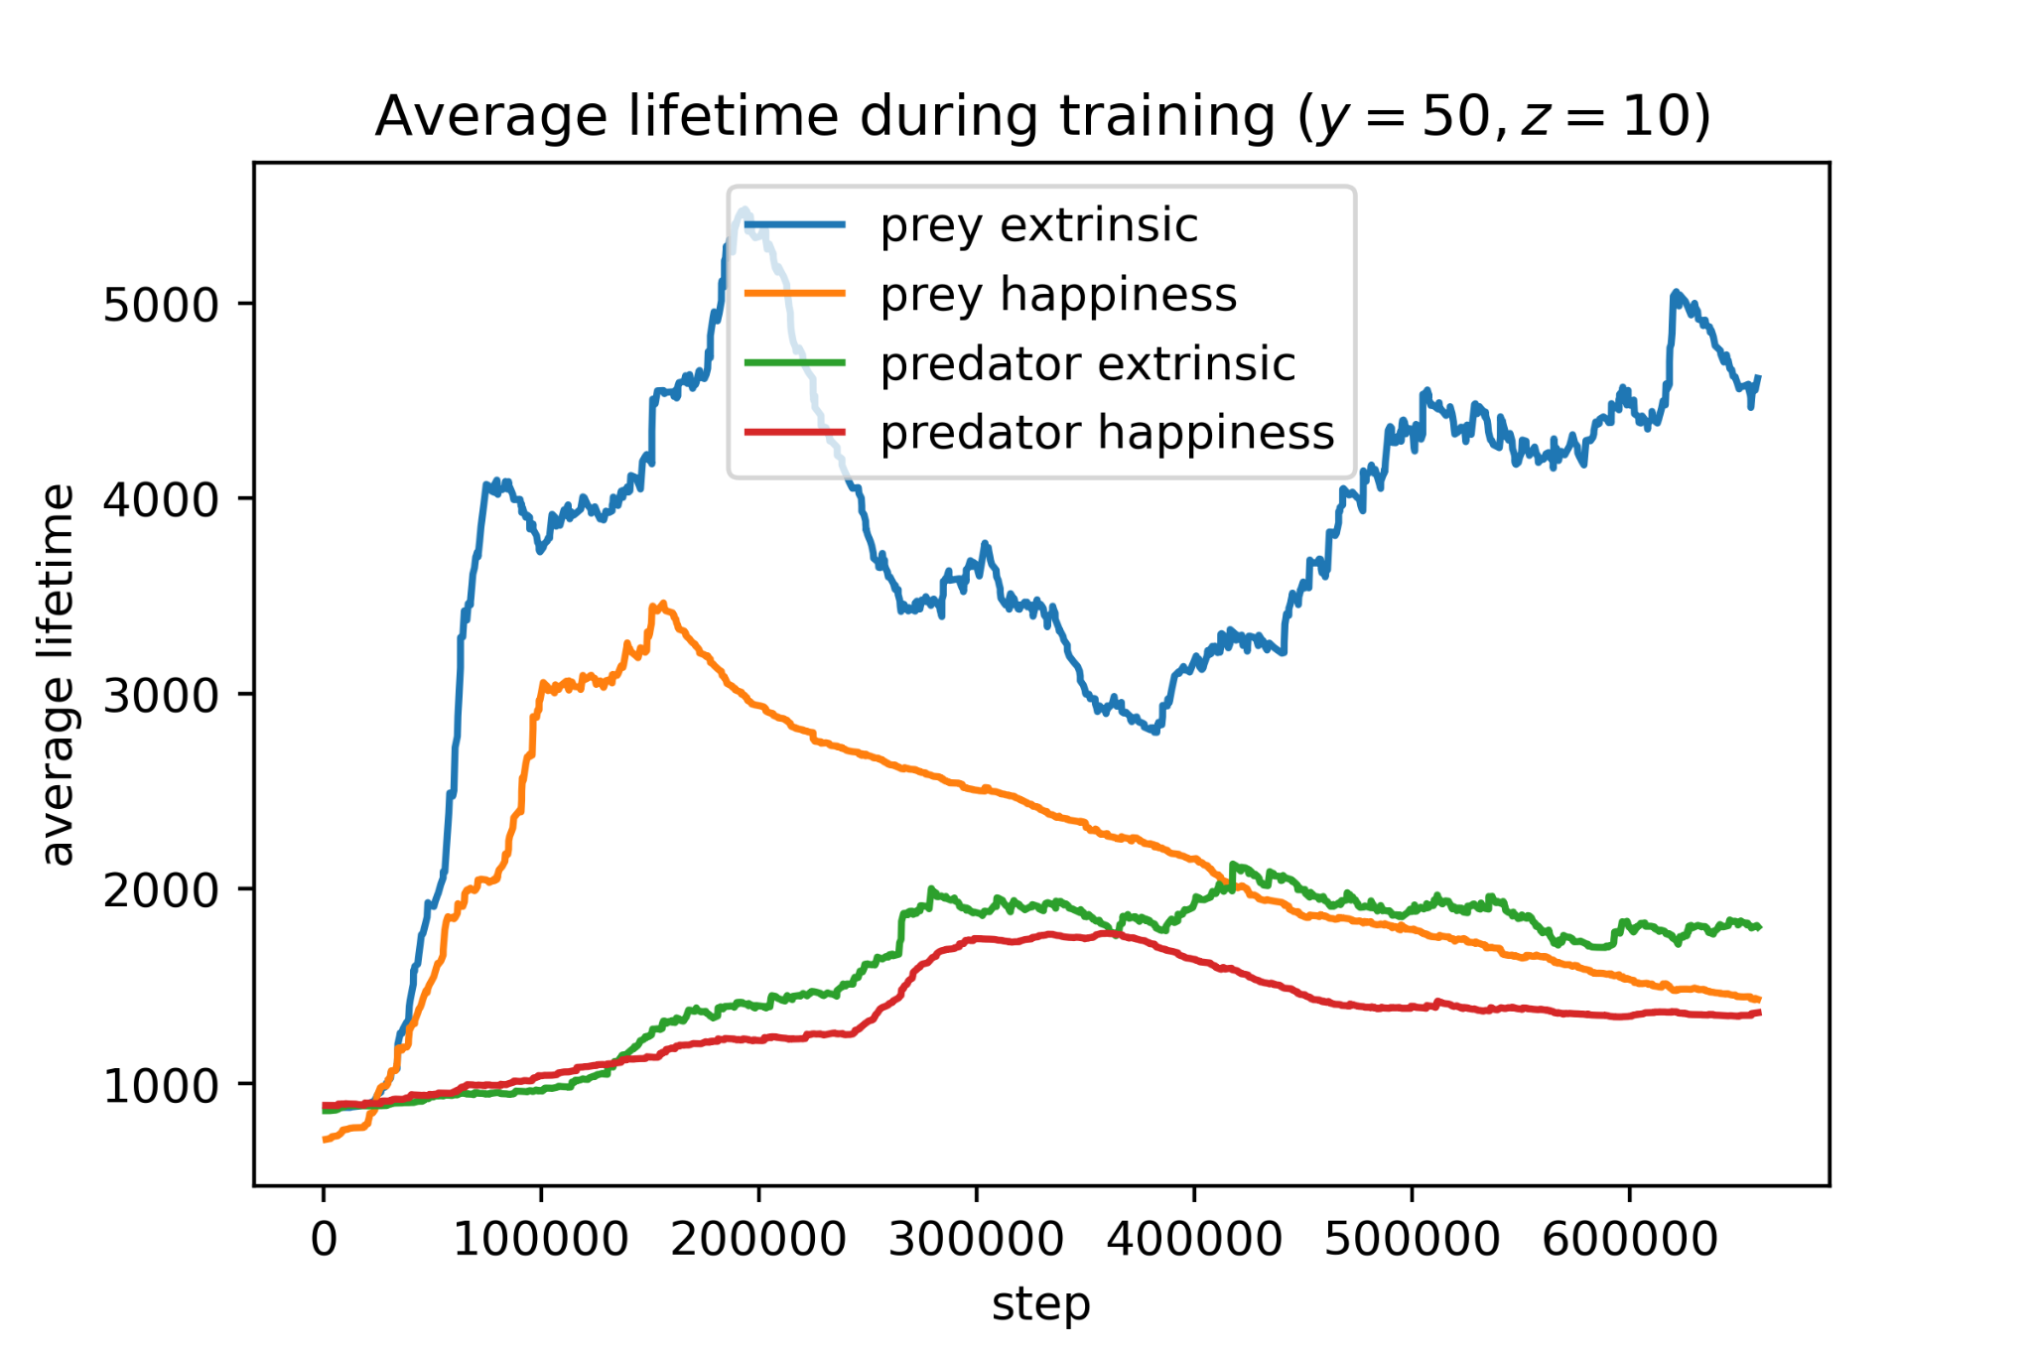



The Happiness Network
Notes:
A brief evaluation of my variant of the happiness network.
Compared it with pure external signal +1 eat, -5 death
Evaluated in three environments with different amount of wolves, 10, 50, 100 respectively.
In the first, the pure external performs better.
Second, where escaping predators and eating needs both to be considered, happiness better.
In third, more equal again.
8. This shows the causes of death for the deers.
9. In the first where there are 10 wolves, it is obvious that the deer trained with the external reward signal mainly dies from predation while the one trained with happiness dies almost exclusively from starvation.
10. This shows that the different reward signals train the deer to prioritize different things.
11. Overall, this might be an indication that he deer trained with happiness might perform better in environment where multiple objective needs to be fulfilled. However, a thorough examination needs to be done.

Slide 38
Summary
Exhibit cyclic dynamics where random agents do not.
2. Non linear parameter responses.
Functional response is nonlinear
3. Experimenting with different physical configuration.
4. The Happiness network works, need further investigation.
5. Unity might be useful to create complex ecosystems.
Notes:
The simulated ecosystem with trained agents exhibit cyclic LV dynamics where random agents do not.
The parameter response estimation shows that the functional and numerical responses are non-linear. Possibly due to more realistic dynamics.
The simulation environment can be used to make many experiments which are hard to do in a real-world environment. Such as measuring changes when the physical properties are altered.
The Happiness network might be a promising approach when the goal of the agents are multi-dimensional, such as many homeostatic variables, but are not much better than a simple reward system in these more simple environments.
Building the simulation environment in the Unity game engine enables usage of prebuilt gameobjects, a physics game engine, wind, etc. It also give a visually rich environment which makes qualitative analysis easier.

Slide 39
Limitations
Not straightforward how to compare the model with the simulation.
The amount of research of the LV model is huge.
Running the simulation in Unity makes the RL part possibly slow.
Could maximally run with 500 agents simultaneously in Unity.
Multi agent reinforcement learning, computationally demanding. Limited amount of data points.
Have only considered one happiness network configuration, it needs further exploration.
Notes:
The LV model is A MODEL. It is known to not be realistic. To evaluate whether the simulated environment is realistic, it has to be compared with the real world. However, we can still compare the simulation dynamics with the LV model to say something about some properties.
The amount of research of the LV model is huge. Hard to find and cover all relevant articles. However, those related to RL I believe is mostly considered.
Running the simulation in Unity makes the RL part possibly slower than other environments, such as a custom gridworld.
Could maximally run with 500 agents simultaneously in Unity.
Running experiments in a multi-agent simulation is very computationally demanding. Long simulation times. Fewer samples might make it harder to statistically verify result.
Have only considered one happiness network configuration, it needs further exploration.

Slide 40
Future work
Increase realism. Terrain, homeostatic variables, reproduction, etc.
Happiness Network can be improved. (Topic of ongoing thesis)
Exploring the RL-part. Parameters, other algorithms and methods.
Compare with more sophisticated models.
Different types of ecosystems.
Notes:
Huge amount of ways to make the environment more realistic. Multiple homeostatic variables, terrain, other sensors, etc.
Happiness Network can be improved.
Exploring the RL-part. Different algorithms, model-based etc.
Further research in parameter responses with respect to more sophisticated models.
Different types of ecosystems. Here we considered predator-prey. Competitive models exist, where several species compete for common food resources. And combination of the two.

Slide 41

Questions
Notes:
Thanks
Questions

